Slide 1

Course Registration Platform
Simplifying enrollment with an easy-to-use system
Notes:
AI-generated content may be incorrect. ---

Slide 2
Project Overview
Notes:
Introduction, Tech Stack

Slide 3

Introduction
Streamlined Course Enrollment
The platform simplifies course enrollment for both students and administrators, improving efficiency and ease of use.
User-Friendly Dashboard
An intuitive dashboard allows users to register, view, and manage courses seamlessly with minimal learning curve.
Key Functional Features
Includes user authentication, course creation, updating, registration, and deletion for comprehensive management.
Modern Web Technologies
The platform leverages modern technologies to ensure scalability, robustness, and seamless user experience.
Notes:
The Course Registration Platform is a web application developed to streamline the process of course enrollment for students and administrators. It provides a user-friendly interface for managing course data, allowing users to register, view, and interact with course offerings efficiently. The platform is designed to simplify the administrative burden of course management while enhancing the user experience for students. It includes essential features such as user authentication, course creation, updating, registration, and deletion, all accessible through a clean and intuitive dashboard. This project showcases the integration of modern web technologies to deliver a robust and scalable solution for educational institutions.

Slide 4

Tech Stack
Frontend with ReactJS
ReactJS provides a dynamic and responsive user interface for the Course Registration Platform.
Backend Powered by Spring Boot
Spring Boot offers robust and scalable server-side logic to handle application processes efficiently.
PostgreSQL Database
PostgreSQL ensures reliable data storage and efficient retrieval for the platform’s database management.
Integrated Full-Stack Solution
The tech stack enables seamless client-server communication and smooth user experience in enterprise applications.
Notes:
The Course Registration Platform is built using a modern full-stack architecture. The frontend is developed with ReactJS, providing a dynamic and responsive user interface. The backend is powered by Spring Boot, a Java-based framework that ensures robust and scalable server-side logic. PostgreSQL is used as the database management system, offering reliable data storage and retrieval capabilities. This combination of technologies enables seamless communication between the client and server, efficient data handling, and a smooth user experience. The tech stack was chosen for its compatibility, performance, and community support, making it ideal for building enterprise-level web applications.

Slide 5
Authentication Features
Notes:
Welcome Page, Signup Page, Login Page

Slide 6
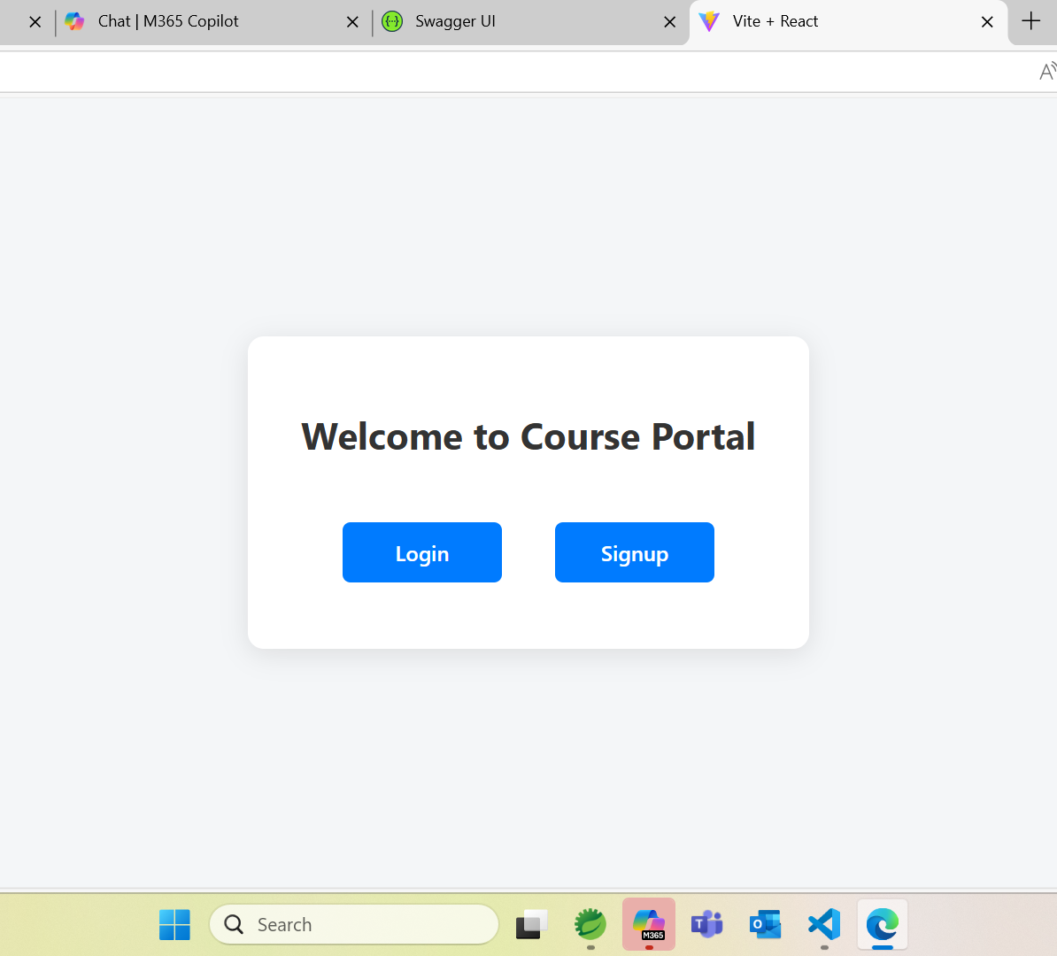
Welcome Page
Entry Point Design
The Welcome Page acts as the main entry point for users accessing the Course Registration Platform.
User Authentication Options
Prominent Login and Signup buttons enable users to easily authenticate or create new accounts.
Accessible Layout
The clean and centered layout emphasizes simplicity and ease of navigation for all users.
Notes:
The Welcome Page serves as the entry point to the Course Registration Platform. It features a clean layout with a centered white box displaying the message 'Welcome to Course Portal' and two prominent blue buttons labeled 'Login' and 'Signup'. This page provides users with immediate access to authentication options, guiding them to either register a new account or log in to an existing one. The design emphasizes simplicity and accessibility, ensuring that users can navigate the platform with ease from the very beginning.

Slide 7
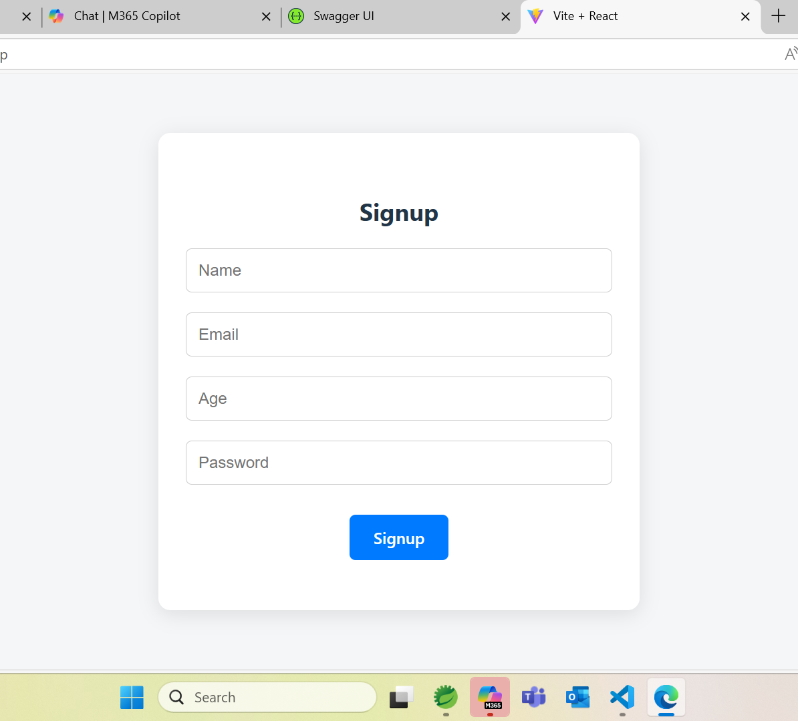
Signup Page
User Information Fields
The signup form collects essential details like name, email, age, and password for account creation.
Clear and Simple Layout
The layout is designed to minimize confusion and promote quick and easy user registration.
Secure Data Collection
The form ensures secure and efficient collection of user data for personalized experience and record keeping.
Notes:
The Signup Page allows new users to create an account on the platform. It includes input fields for Name, Email, Age, and Password, followed by a blue 'Signup' button. This form ensures that all necessary user information is collected securely and efficiently. The layout is straightforward, minimizing user confusion and promoting quick registration. By capturing essential details, the platform can personalize the user experience and maintain accurate records for course registration activities.

Slide 8
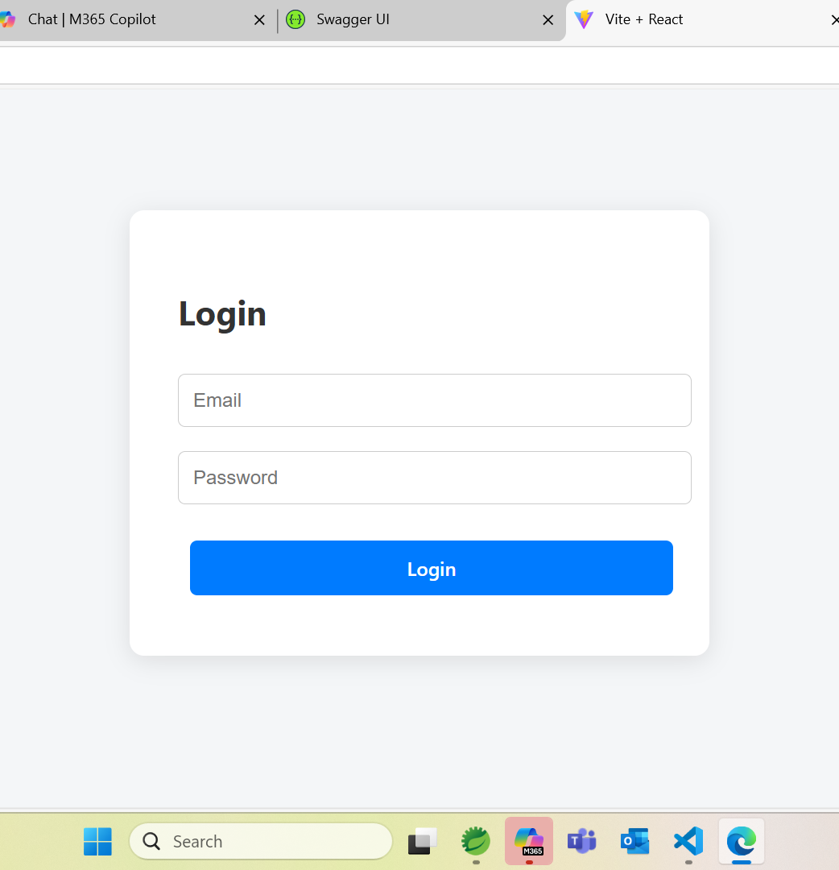
Login Page
User Authentication
The login page securely verifies users with registered email and password credentials.
Simple and Intuitive Design
The form includes only two input fields and a prominently displayed blue 'Login' button for ease of use.
Post-login Navigation
Successful login redirects users to the course dashboard, enabling quick platform access.
User Convenience and Security
The login page balances user convenience with data security for safe and fast access.
Notes:
The Login Page enables existing users to access their accounts using their registered Email and Password. The form is simple and intuitive, featuring two input fields and a blue 'Login' button. This page ensures secure authentication and directs users to the course dashboard upon successful login. The design prioritizes user convenience and security, allowing for quick access to the platform's features while safeguarding user data.

Slide 9
Course Dashboard
Notes:
Dashboard Overview, Sidebar Navigation

Slide 10
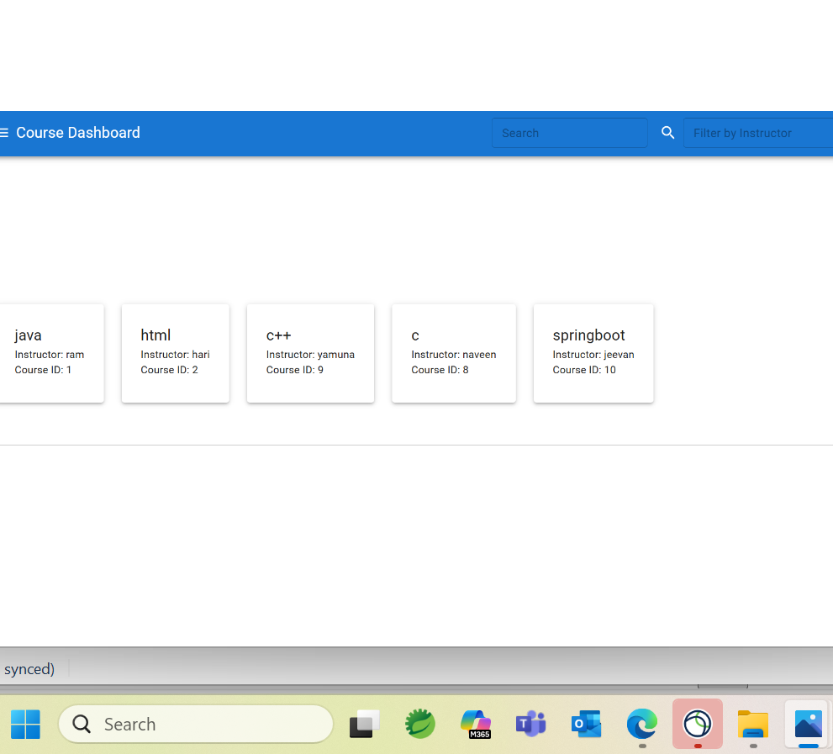

Dashboard Overview
Course Cards Display
Courses are shown in card format featuring course name, instructor, and course ID for clear identification.
Search and Filter Tools
Search bar and filters enable quick and precise course discovery, improving user navigation experience.
User-Friendly Design
The dashboard combines visual appeal with functionality, supporting viewing, filtering, and sorting courses efficiently.
Notes:
The Course Dashboard displays a collection of available courses in a card format, each showing the course name, instructor, and course ID. It includes a search bar and filter options to help users find specific courses quickly. This feature enhances user interaction by allowing efficient navigation through the course offerings. The dashboard is designed to be visually appealing and functional, supporting key operations such as viewing, filtering, and sorting courses.

Slide 11
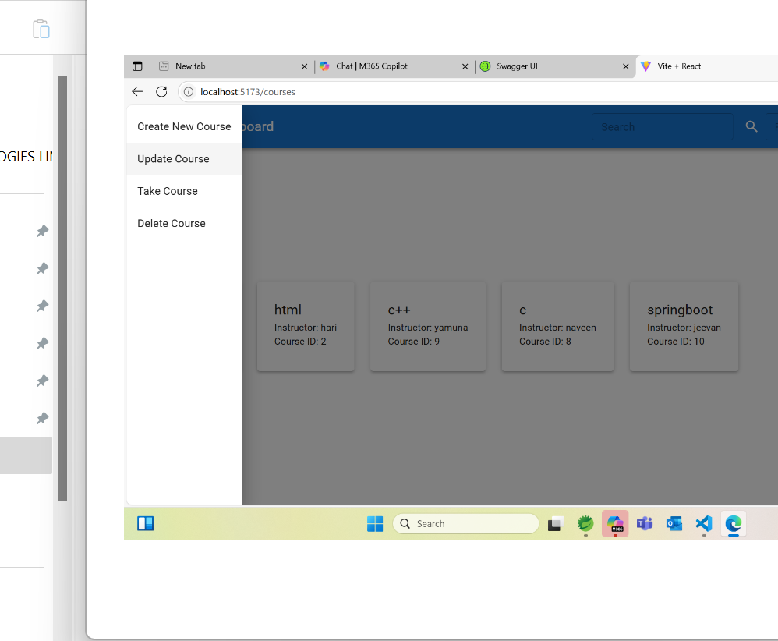
Sidebar Navigation
Core Functionalities Access
Sidebar navigation provides quick access to creating, updating, taking, and deleting courses, improving task efficiency.
Streamlined User Interaction
Grouping related course actions in the sidebar enhances workflow and reduces the need to navigate away from the dashboard.
Enhanced Usability
The sidebar improves overall usability by supporting efficient workflow and creating a cohesive user experience.
Notes:
The sidebar menu on the dashboard provides quick access to core functionalities: Create New Course, Update Course, Take Course, and Delete Course. This navigation panel streamlines user interaction by grouping related actions in one place. It supports efficient workflow management and ensures that users can perform course-related operations without navigating away from the dashboard. The sidebar enhances usability and contributes to a cohesive user experience.

Slide 12
CRUD Operations
Notes:
Create Course, Update Course, Take Course, Delete Course

Slide 13
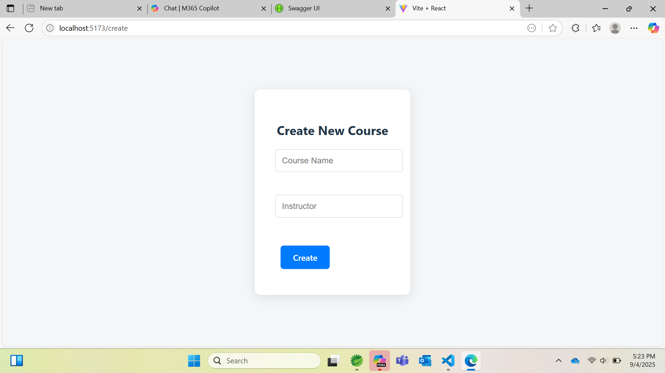
Create Course
Course Creation Form
The form includes input fields for Course Name and Instructor to capture essential course data accurately.
Create Button Design
A prominent blue 'Create' button enables users to easily submit new course information.
User-Friendly Interface
The interface is designed for ease of use, allowing quick course creation and immediate dashboard availability.
Notes:
The Create Course page allows administrators to add new courses to the platform. It includes input fields for Course Name and Instructor, along with a blue 'Create' button. This form ensures that new course data is captured accurately and added to the database. The interface is designed for ease of use, enabling quick course creation and immediate availability on the dashboard. This feature supports the dynamic expansion of course offerings.

Slide 14
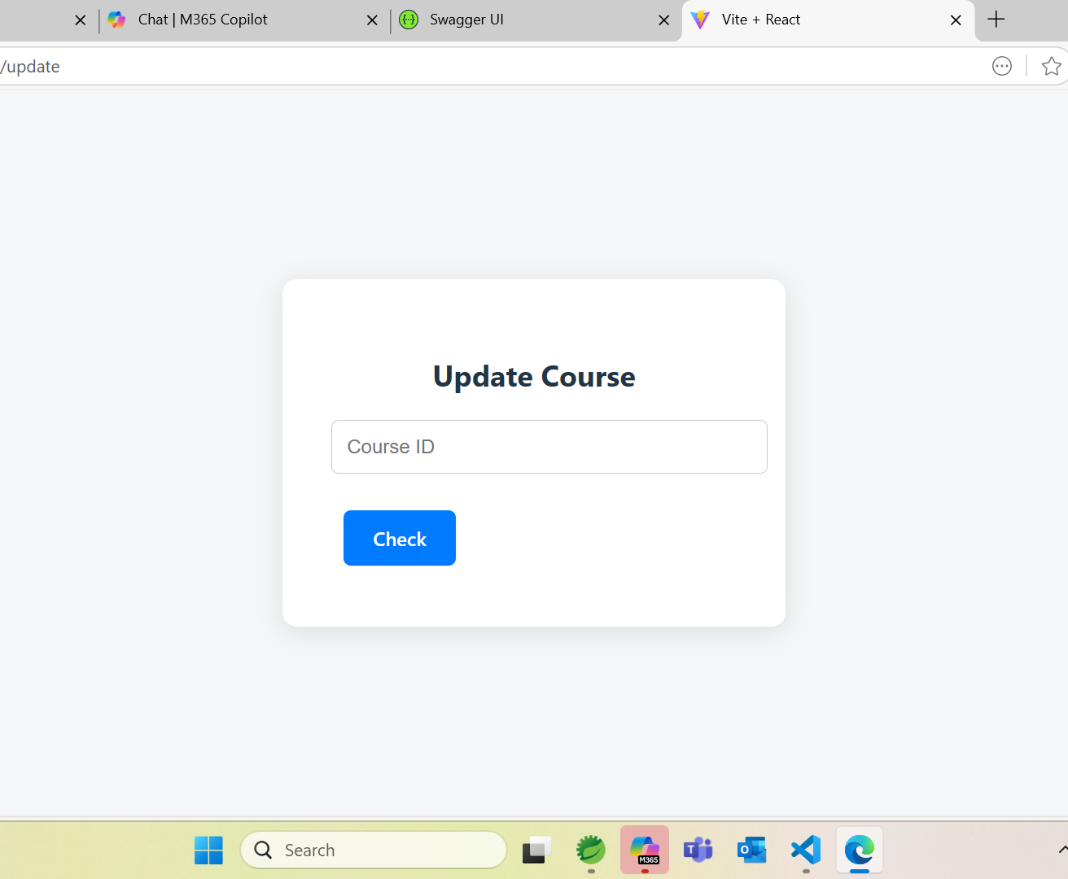
Update Course
Course Retrieval by ID
Users enter a Course ID to fetch existing course details for review and modification.
Validation Check Feature
The 'Check' button verifies course existence before allowing updates to maintain data integrity.
Efficient and Error-Minimized Updates
Design supports efficient course updates while minimizing errors through prior validation.
Notes:
The Update Course page provides functionality to modify existing course details. Users enter the Course ID to retrieve and update the relevant information. The form includes a 'Check' button to validate the course before making changes. This feature ensures data integrity and allows administrators to keep course information current. The design supports efficient updates and minimizes errors by verifying course existence prior to modification.

Slide 15
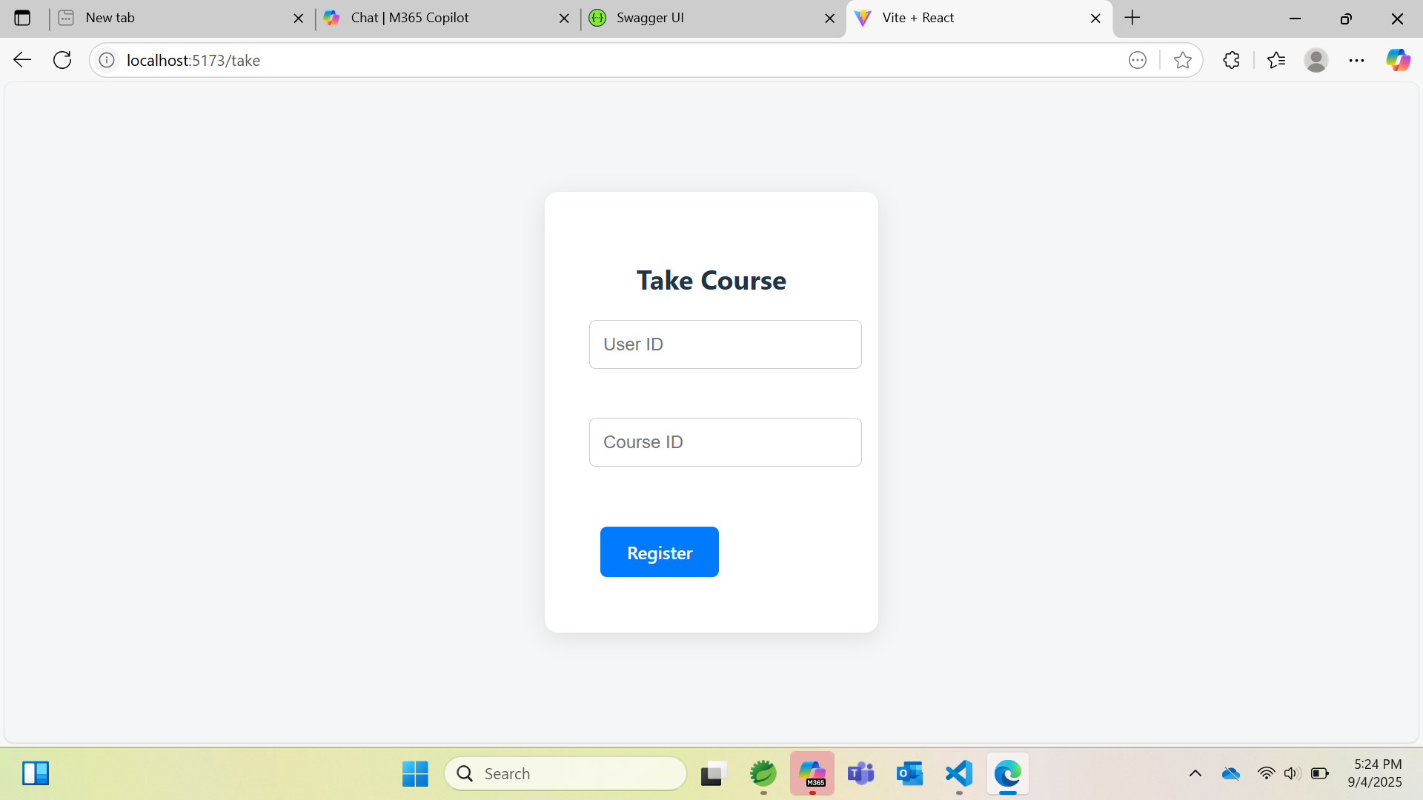
Take Course
User Registration Process
Users enter their User ID and Course ID to register for a course seamlessly through the platform.
Submit Registration Action
A blue 'Register' button efficiently submits the registration form, linking users to their desired courses.
User Engagement and Functionality
The simple and direct form design promotes user engagement and supports core platform functions.
Notes:
The Take Course page enables users to register for a course by entering their User ID and the desired Course ID. A blue 'Register' button submits the form, linking the user to the selected course. This feature facilitates enrollment and ensures that user-course associations are recorded accurately. The form is simple and direct, promoting user engagement and supporting the core functionality of the platform.

Slide 16
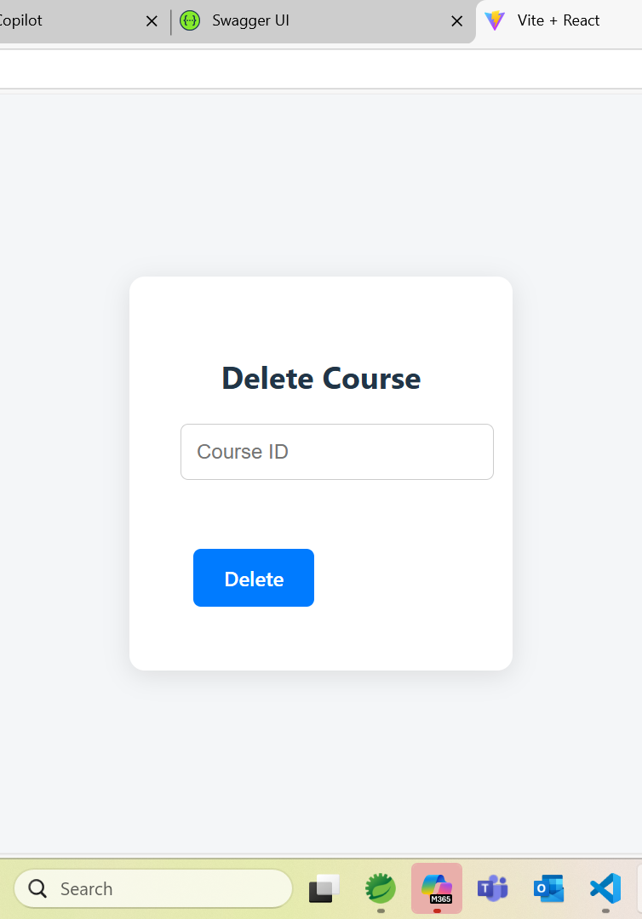
Delete Course
Purpose of Deletion Feature
Allows administrators to remove outdated or irrelevant courses to maintain catalog accuracy.
User Interaction
Users enter Course ID and click a blue 'Delete' button to perform the deletion.
Interface Design
Designed for quick and secure deletion supporting efficient course management.
Notes:
The Delete Course page allows administrators to remove courses from the platform. Users input the Course ID and click the blue 'Delete' button to execute the operation. This feature ensures that outdated or irrelevant courses can be efficiently removed, maintaining the relevance and accuracy of the course catalog. The interface is designed for quick and secure deletion, supporting effective course management.

Slide 17
Conclusion
Notes:
Project Summary

Slide 18

Project Summary
Full-Stack Technology Integration
The platform leverages ReactJS, Spring Boot, and PostgreSQL for a seamless frontend and robust backend experience.
User Authentication Features
Secure user authentication ensures safe and personalized access to course registration functionalities.
Course Management Workflow
Efficient workflows simplify course registration and administrative tasks in educational settings.
Real-World Problem Solving
The project highlights developer skills in applying modern technologies to address educational challenges.
Notes:
The Course Registration Platform demonstrates a comprehensive full-stack web application with essential features for user authentication and course management. Built using ReactJS, Spring Boot, and PostgreSQL, the platform offers a seamless user experience and robust backend support. Through intuitive interfaces and efficient workflows, it simplifies the process of course registration and administration. This project highlights the developer's proficiency in integrating modern technologies to solve real-world problems in educational settings.

